Slide 1

Chapter 10 ~ Basic Image Segmentation
Heaven’s Light is Our Guide
Department of Computer Science & Engineering
Rajshahi University of Engineering & Technology, Rajshahi-6204, Bangladesh.
S. M. Mahedy Hasan
Assistant Professor, Dept. of CSE
RUET, Rajshahi-6204, Bangladesh.

Slide 2
Image Analysis
Image analysis is the extraction of meaningful information from images.
It is a prior task of object recognition.
Image analysis gives input to the object recognition task.
Image analysis involves three sub-tasks:
Segmentation
Feature Extraction
Classification

Slide 3

Image Analysis (Edge Detection)

Slide 4
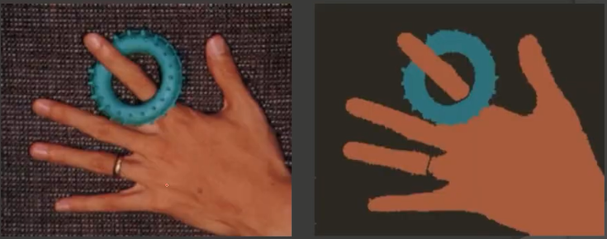
Image Analysis (Segmentation)

Slide 5
Image Segmentation
Segmentation subdivides an image into its constituent regions or objects. It indicates the discontinuities in an image.
Segmentation is a process of grouping together pixels that have similar attributes.
Image Segmentation is the process of partitioning an image into non-intersecting regions such that each region is homogeneous and the union of no two adjacent regions is homogeneous. The two adjacent regions are disjoint or differentiable.

Slide 6
Image Segmentation
Objectives
To find individual objects in an image OR
To subdivide an image into its constituent regions or objects to simplify and/or change the representation of an image into something that is more meaningful and easier to analyze
Typically used to locate objects and boundaries (lines, curves, etc.) in images

Slide 7
Segmentation Approach
Segmentation algorithms generally are based on one of two basic properties of intensity values.
1. Discontinuity
Partitioning based on abrupt changes in intensity such as edges.
2. Similarity
Partitioning into regions based on predefined criteria (pixel intensity, color, texture etc.)

Slide 8
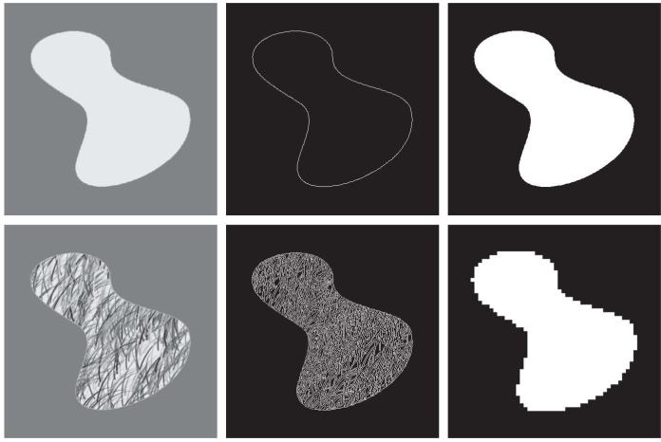

Segmentation Approach
Figure 1: (a) Image containing a region of constant intensity. (b) Image showing the boundary of the inner region, obtained from intensity discontinuities. (c) Result of segmenting the image into two regions. (d) Image containing a textured region. (e) Result of edge computations. Note the large number of small edges that are connected to the original boundary, making it difficult to find a unique boundary using only edge information. (f) Result of segmentation based on region properties.

Slide 9
Detection of Dis-continuities
Detecting basic types of discontinuities:
Lines
Points
Edges

Slide 10
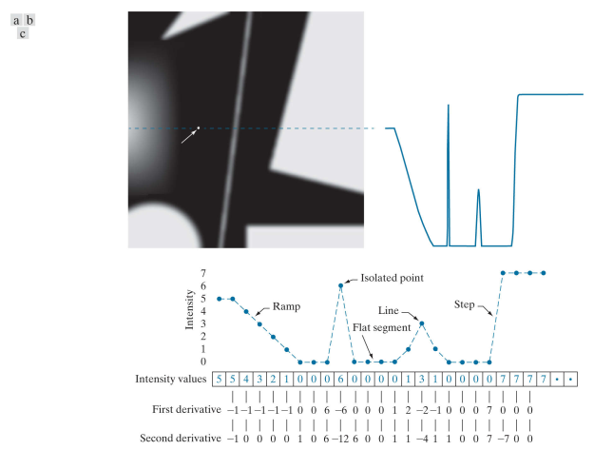
Detection of Dis-continuities

Slide 11
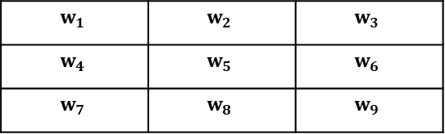

Detection of Discontinuities
The common way is to run a small mask over the image
The mask determines which types of discontinuities we are actually looking for.
$$R=w_{1}z_{1}+w_{2}z_{2}+⋯+w_{9}z_{9}$$
$$=\sum_{k=1}^{9}{ } w_{k}z_{k}$$
$$w_{1}$$ | $$w_{2}$$ | $$w_{3}$$
$$w_{4}$$ | $$w_{5}$$ | $$w_{6}$$
$$w_{7}$$ | $$w_{8}$$ | $$w_{9}$$

Slide 12

Detection of Discontinuities
$$Δ^{2}f=\frac{∂^{2}f}{∂x^{2}}+\frac{∂^{2}f}{∂y^{2}}$$
$$\frac{∂^{2}f}{∂x^{2}}=f(x+1,y)+f(x−1,y)−2f(x,y)$$
$$\frac{∂^{2}f}{∂y^{2}}=f(x,y+1)+f(x,y−1)−2f(x,y)$$
$$Δ^{2}f=f(x+1,y)+f(x−1,y)+f(x,y+1)+f(x,y−1)−4f(x,y)$$

Slide 13
Detection of Discontinuities
$$Δ^{2}f=f(x+1,y)+f(x−1,y)+f(x,y+1)+f(x,y−1)−4f(x,y)$$
f(x-1,y-1) | f(x-1,y) | f(x-1,y+1)
f(x,y-1) | f(x,y) | f(x,y+1)
f(x+1, y-1) | f(x+1, y) | f(x+1, y+1)
$$z_{1}$$ | $$z_{2}$$ | $$z_{3}$$
$$z_{4}$$ | $$z_{5}$$ | $$z_{6}$$
$$z_{7}$$ | $$z_{7}$$ | $$z_{9}$$
0 | 1 | 0
1 | -4 | 1
0 | 1 | 0
0 | -1 | 0
-1 | 4 | -1
0 | -1 | 0
Laplacian Mask
Laplacian Mask

Slide 14
Detection of Discontinuities
The diagonal directions can be incorporated in the definition of the digital Laplacian:
$Δ^{2}f=f(x+1,y)+f(x−1,y)+f(x,y+1)+f(x,y−1)−4f(x,y)$ $+f(x−1,y−1)+f(x+1,y+1)−2f(x,y)+f(x+1,y−1)$ $+f(x−1,y+1)−2f(x,y)$
$Δ^{2}f=f(x+1,y)+f(x−1,y)+f(x,y+1)+f(x,y−1)+f(x−1,y−1)+f(x+1,y+1)+f(x+1,y−1)+f(x−1,y+1$)$−8f(x,y)$

Slide 15
Detection of Discontinuities
$Δ^{2}f=f(x+1,y)+f(x−1,y)+f(x,y+1)+f(x,y−1)+f(x−1,y−1)+f(x+1,y+1)+f(x+1,y−1)+f(x−1,y+1$)$−8f(x,y)$
1 | 1 | 1
1 | -8 | 1
1 | 1 | 1
-1 | -1 | -1
-1 | 8 | -1
-1 | -1 | -1
Laplacian Mask
Laplacian Mask

Slide 16
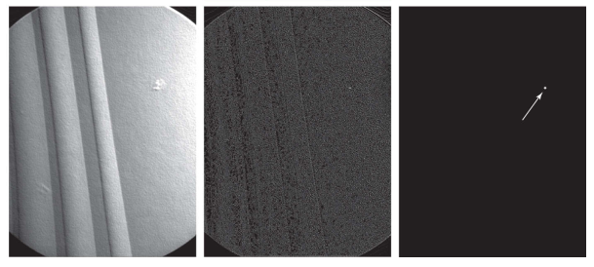

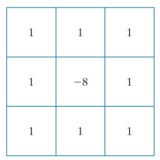
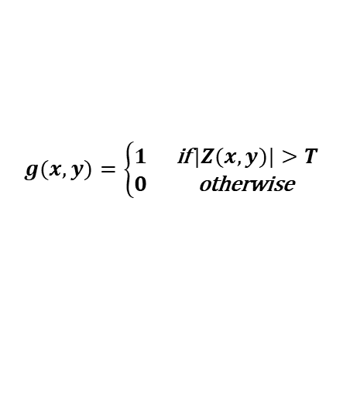
Detection of Discontinuities (Isolated Points)
$$g(x,y)=\left\{\begin{matrix}1 & \text{if} |Z(x,y)|>T \\ 0 & \text{otherwise} \end{matrix}\right.$$
Figure 2: (a) Laplacian kernel used for point detection. (b) X-ray image of a turbine blade with a porosity manifested by a single black pixel. (c) Result of convolving the kernel with the image. (d) Result of using a non-negative threshold.

Slide 17

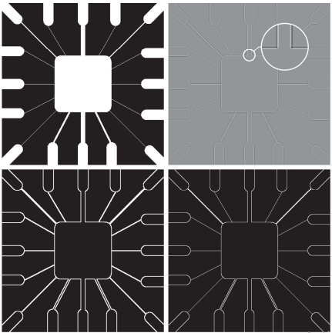
Detection of Discontinuities (Line Detection)
Figure 3: (a) Original image. (b) Laplacian image; the magnified section shows the positive/negative double-line effect characteristic of the Laplacian. (c) Absolute value of the Laplacian. (d) Positive values of the Laplacian.

Slide 18
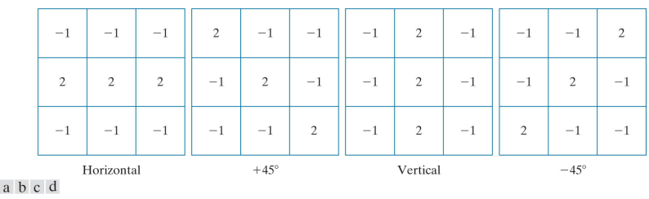
Detection of Discontinuities (Line Detection)
Figure 4: Line detection kernels. Detection angles are with respect to the axis system in with positive angles measured counterclockwise.

Slide 19
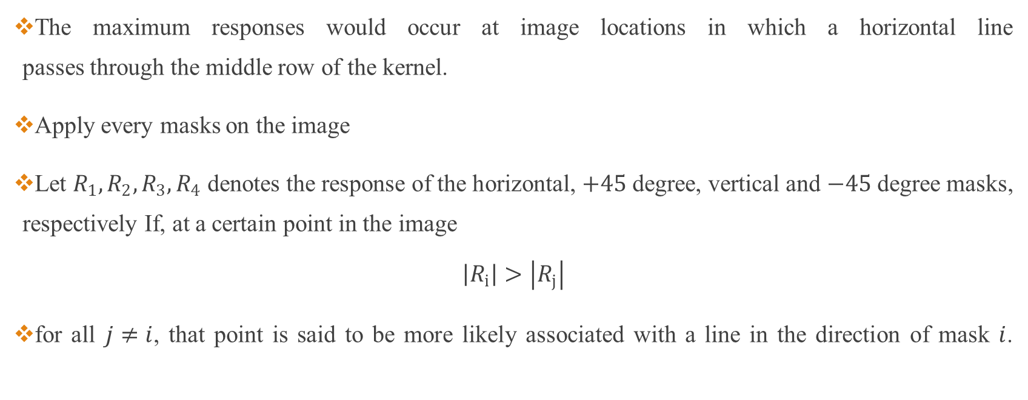
Detection of Discontinuities (Line Detection)
The maximum responses would occur at image locations in which a horizontal line passes through the middle row of the kernel.
Apply every masks on the image
Let $R_{1},R_{2},R_{3},R_{4}$ denotes the response of the horizontal, $+45$ degree, vertical and $−45$ degree masks, respectively If, at a certain point in the image
$$\left|R_{i}\right|>\left|R_{j}\right|$$
for all $j≠i$, that point is said to be more likely associated with a line in the direction of mask $i$.

Slide 20
Detection of Discontinuities (Line Detection)
How to detect lines in a specified direction?
Use the mask associated with that direction and threshold it’s output.

Slide 21
Edge Detection
What is an edge?
Set of connected pixels that lie on the boundary between two regions.
Edge pixels are pixels at which the intensity of an image changes abruptly, and edges (or edge segments) are sets of connected edge pixels.

Slide 22
Edge Detection
Edge detection techniques
Gradient operators
Roberts cross-gradient operators
Prewitt operators
Sobel operators
More advanced techniques
Marr-Hildreth edge detector / LoG operator
Canny edge detector

Slide 23

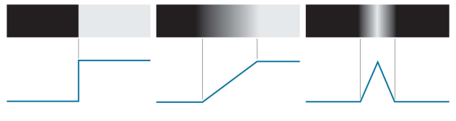
Edge Detection
Figure 4: From left to right, models (ideal representations) of a step, a ramp, and a roof edge, and their corresponding intensity profiles.

Slide 24
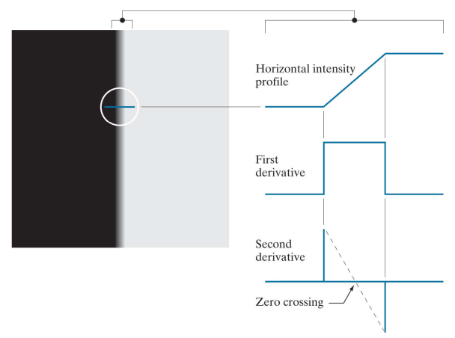
Edge Detection

Slide 25
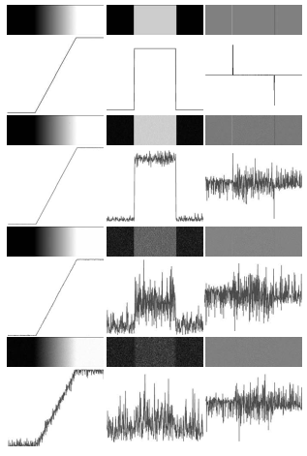
Behavior of the first and second derivatives in the region of a noisy edge
Figure 5: First column: Images and intensity profiles of a ramp edge corrupted by random Gaussian noise of zero mean and standard deviations of 0.0, 0.1, 1.0, and 10.0 intensity levels, respectively. Second column: First derivative images and intensity profiles. Third column: Second-derivative images and intensity profiles.

Slide 26
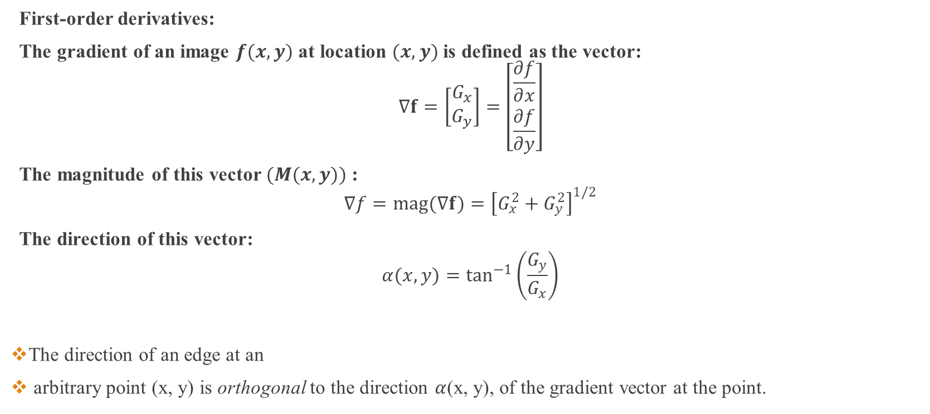
Gradient Operators
First-order derivatives:
The gradient of an image $f(x,y)$ at location $(x,y)$ is defined as the vector:
$$∇f=\left[\begin{matrix}G_{x} \\ G_{y}\end{matrix}\right]=\left[\begin{matrix}\frac{∂f}{∂x} \\ \frac{∂f}{∂y}\end{matrix}\right]$$
The magnitude of this vector $(M(x,y))$ :
$$∇f=mag(∇f)={\left[G_{x}^{2}+G_{y}^{2}\right]}^{1/2}$$
The direction of this vector:
$$α(x,y)=\tan^{−1}\left(\frac{G_{y}}{G_{x}}\right)$$
The direction of an edge at an
arbitrary point (x, y) is orthogonal to the direction $α$(x, y), of the gradient vector at the point.

Slide 27
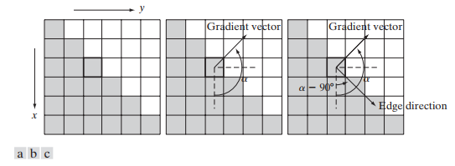
Gradient Operators
The magnitude will be higher along that direction.
It points in the direction of maximum rate of change of ‘f’ at co-ordinates (x, y).
It gives maximum rate of increase of f (x,y).
This is also known as a gradient image.
Figure: Using the gradient to determine edge strength and direction at a point. Note that the edge is perpendicular to the direction of the gradient vector at the point where the gradient is computed. Each square in the figure represents one pixel.

Slide 28
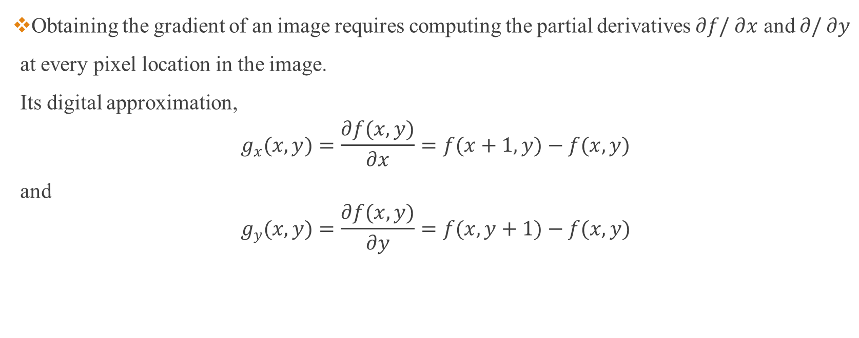
Gradient Operators
Obtaining the gradient of an image requires computing the partial derivatives $∂f/∂x$ and $∂/∂y$ at every pixel location in the image. Its digital approximation,
$$g_{x}(x,y)=\frac{∂f(x,y)}{∂x}=f(x+1,y)−f(x,y)$$
and
$$g_{y}(x,y)=\frac{∂f(x,y)}{∂y}=f(x,y+1)−f(x,y)$$

Slide 29
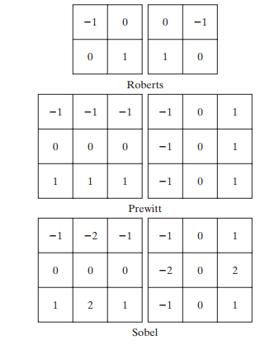
Gradient Operators

Slide 30
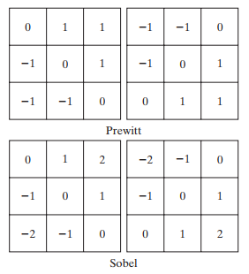
Gradient Operators
Figure: Prewitt and Sobel masks for detecting diagonal edges.

Slide 31
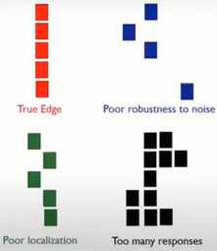
Properties of Edge Detector
Low error rate
All edges should be found (Good detection).
Edge points should be well localized
The edges located must be as close as possible to the true edges (Good localization).
Single edge point response
The detector should return only one point for each true edge point (Single response).

Slide 32
Canny Edge Detector Algorithm
Algorithm
1. Smoothing: Blurring of the image to remove noise (Low-pass spatial filtering: Guassian)
2. Finding gradients: The edges should be marked where the gradients of the image has large magnitudes (Application of first-order differential masks)
3. Non-maximum suppression: Only local maxima should be marked as edges
4. Double thresholding: Potential edges are determined by thresholding
5. Edge tracking by hysteresis: Final edges are determined by suppressing all edges that are not connected to a very certain (strong) edge

Slide 33
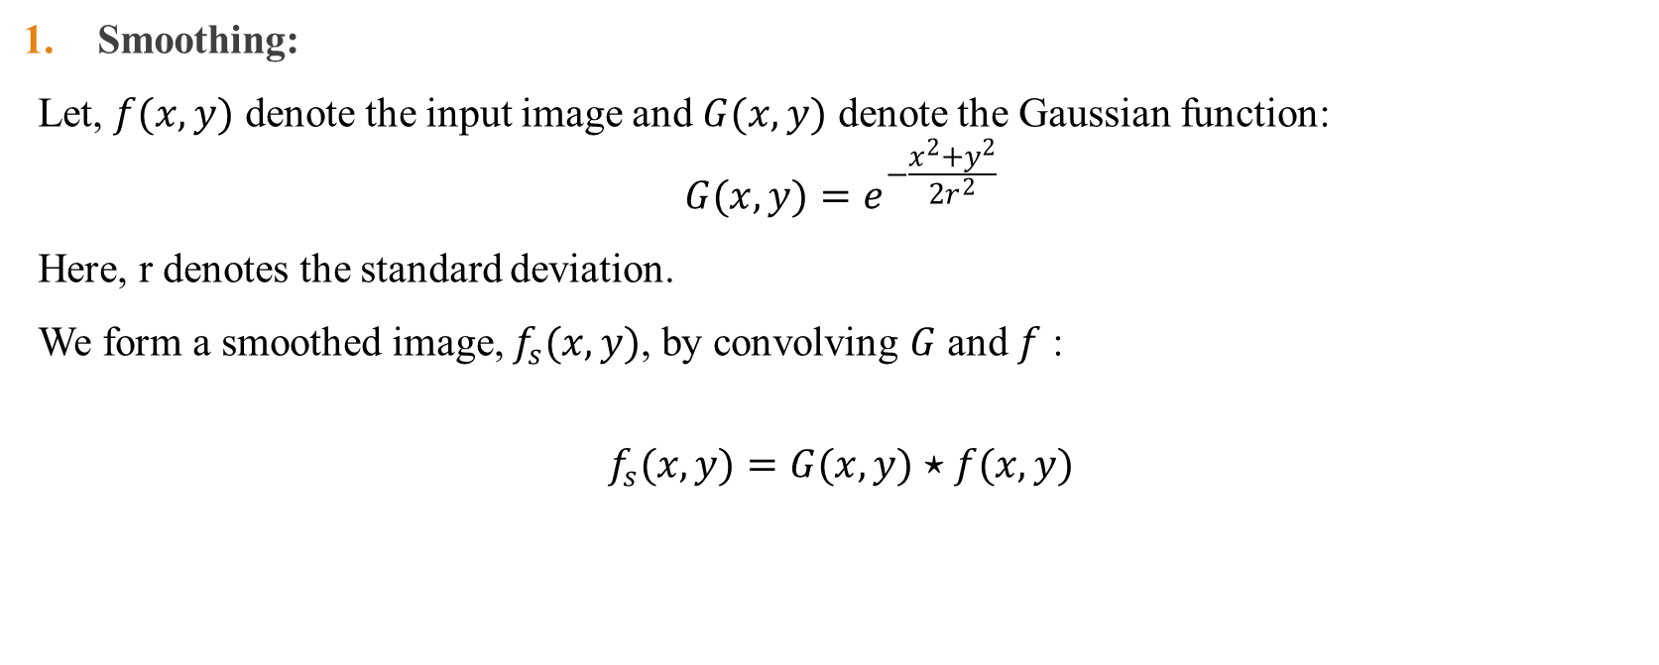
Canny Edge Detector
Smoothing:
Let, $f(x,y)$ denote the input image and $G(x,y)$ denote the Gaussian function:
$$G(x,y)=e^{−\frac{x^{2}+y^{2}}{2r^{2}}}$$
Here, r denotes the standard deviation.
We form a smoothed image, $f_{s}(x,y)$, by convolving $G$ and $f$ :
$$f_{s}(x,y)=G(x,y)⋆f(x,y)$$

Slide 34
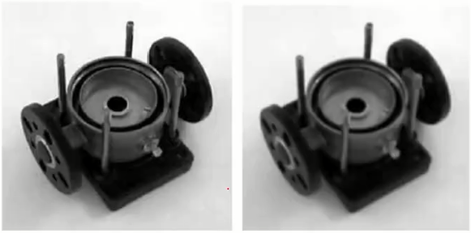
Canny Edge Detector
Original Image
Smoothed Image

Slide 35
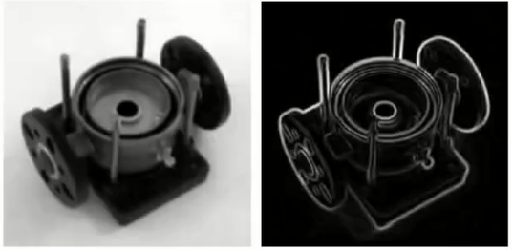
Canny Edge Detector
2. Finding Gradient:
Gradients at each pixel in the smooth images are determined by applying the Sobel-Operator.
But, the problem is that we are getting thick edges.
Smoothed Image
Edge Image

Slide 36
Canny Edge Detector
3. Non-maximum suppression
The purpose is to convert the "blurred" edges in the image of the gradient magnitudes to "sharp" edges
Preserve all local maxima in the gradient image, and delete everything else.
Compare the edge strength (magnitude) of the current pixel with the edge strength of the pixel in the positive and negative gradient direction.
If the edge strength of the current pixel is largest; preserve the value of the edge strength. If not, suppress (i.e. remove) the value.

Slide 37
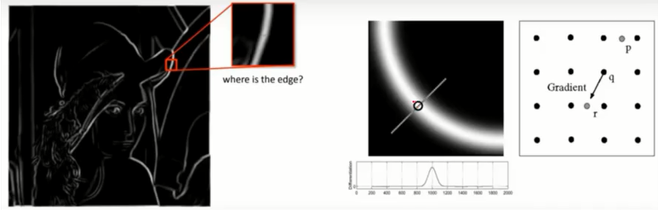
Canny Edge Detector
3. Non-maximum suppression

Slide 38
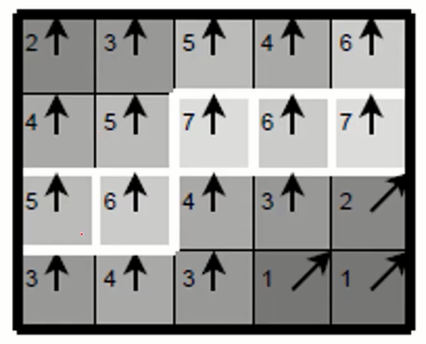
Canny Edge Detector
3. Non-maximum suppression
The edge strengths are indicated both as colors and numbers, while the gradient directions are shown as arrows.
The resulting edge pixels are marked with white borders.

Slide 39
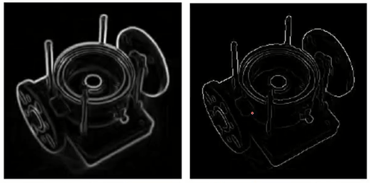
Canny Edge Detector
3. Non-maximum suppression: Edge pixels are only preserved when the gradient has local maxima.
Thick Edge
Non-maximum suppression

Slide 40
Canny Edge Detector
4. Double Thresholding
- Edge pixels stronger than the high threshold are marked as strong
- Edge pixels weaker than the low threshold are suppressed
- Edge pixels between the two thresholds are marked as weak

Slide 41

Canny Edge Detector
In the second image, strong edges are white, while weak edges are grey. Edges with a strength below thresholds are suppressed.
Edges after non-maximum suppression
Edges after double thresholding

Slide 42
Canny Edge Detector
5. Edge Tracking by Hysteresis
- Strong edges are interpreted as "certain edges", and can immediately be included in the final edge image
- Weak edges are included if and only if they are connected to strong edges

Slide 43
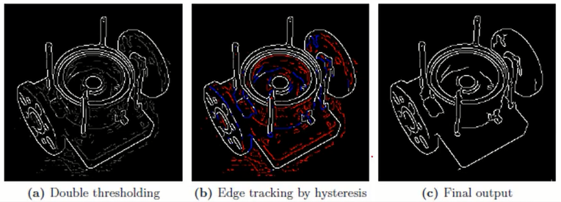
Canny Edge Detector
The middle image shows strong edges in white, weak edges connected to strong edges in blue, and other weak edges are in red.

Slide 44
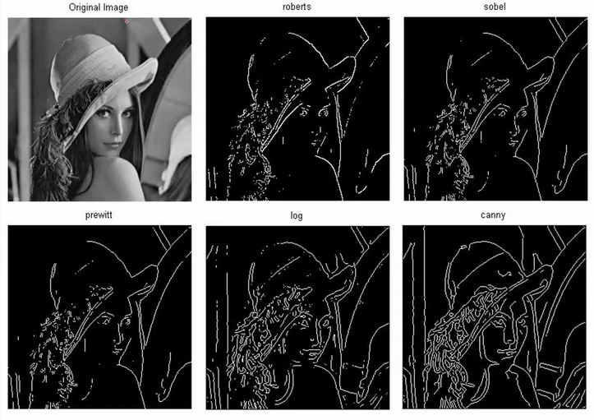
Edge detection comparison

Slide 45
Region Based Segmentation
Edges and thresholds sometimes do not give good results for segmentation
Region-based segmentation is based on the connectivity of similar pixels in a region.
Each region must be uniform (color, intensity values, texture etc…..)
Connectivity of the pixels within the region is defined (4, 8 adjacency etc…..)
Approaches to region-based segmentation:
Region growing
Region splitting

Slide 46
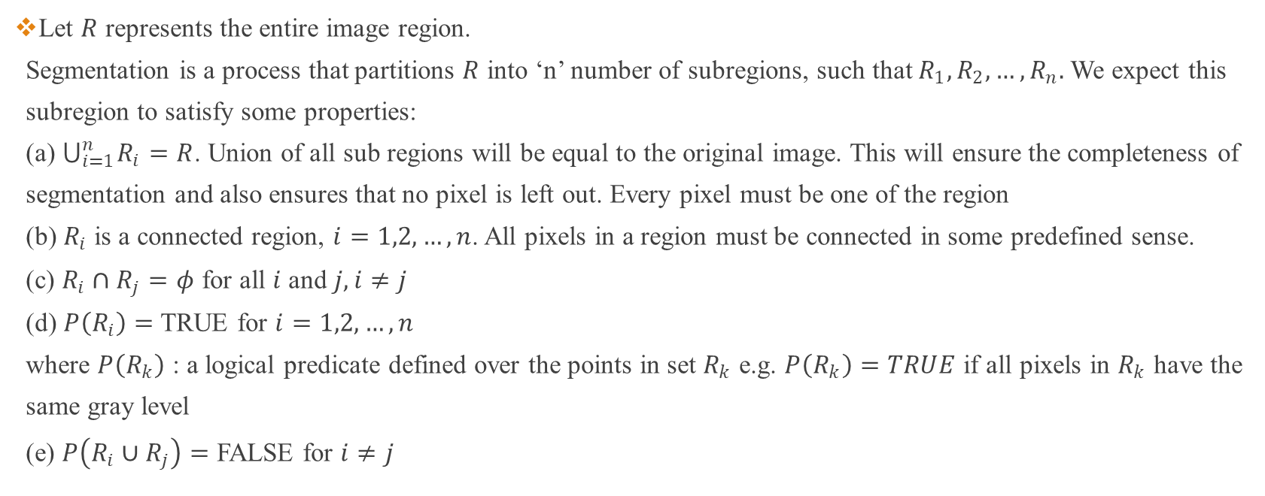
Region Based Segmentation
Let $R$ represents the entire image region. Segmentation is a process that partitions $R$ into ‘n’ number of subregions, such that $R_{1},R_{2},…,R_{n}.$We expect this subregion to satisfy some properties: (a) $⋃_{i=1}^{n} R_{i}=R$. Union of all sub regions will be equal to the original image. This will ensure the completeness of segmentation and also ensures that no pixel is left out. Every pixel must be one of the region (b) $R_{i}$ is a connected region, $i=1,2,…,n$. All pixels in a region must be connected in some predefined sense. (c) $R_{i}∩R_{j}=φ$ for all $i$ and $j,i≠j$ (d) $P\left(R_{i}\right)=$ TRUE for $i=1,2,…,n$ where $P\left(R_{k}\right)$ : a logical predicate defined over the points in set $R_{k}$ e.g. $P\left(R_{k}\right)=TRUE$ if all pixels in $R_{k}$ have the same gray level (e) $P\left(R_{i}∪R_{j}\right)=$ FALSE for $i≠j$

Slide 47
Region Growing
Grouping of pixels or subregions into larger regions based on predefined criteria for growth General Procedure.
Start with a set of "seed" points.
From each seed, grow regions by appending the neighboring pixels with similar properties (of seed).

Slide 48
Region Growing
Algorithms may vary and depends on
The similarity criteria (predicate values) used to decide whether a pixel should be included in the region or not.
Depends on problem
Type of image data
The connectivity type (4, 8 adjacency etc….) used to determine neighbors.
The strategy (BFS or DFS manner) used to visit neighboring pixels.
Decide the stopping rule
- stops when no more pixels satisfy the criteria.

Slide 49
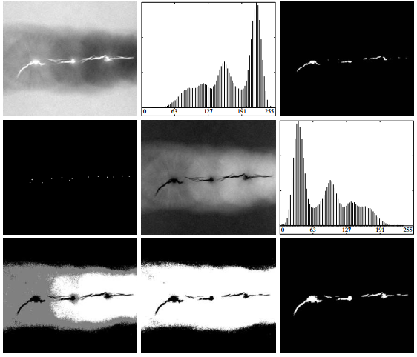

Region Growing
Figure: (a) X-ray image of a defective weld. (b) Histogram. (c) Initial seed image. (d) Final seed image (the points were enlarged for clarity). (e) Absolute value of the difference between (a) and (c). (f) Histogram of (e). (g) Difference image thresholded using dual thresholds. (h) Difference image thresholded with the smallest of the dual thresholds. (i) Segmentation result obtained by region growing. (Original image courtesy of X-TEK Systems, Ltd.)

Slide 50
Region Growing
Figure shows an 8-bit X-ray image of a weld (the horizontal dark region) containing several cracks and porosities (the bright regions running horizontally through the center of the image). We illustrate the use of region growing by segmenting the defective weld regions. These regions could be used in applications such as weld inspection, for inclusion in a database of historical studies, or for controlling an automated welding system.

Slide 51
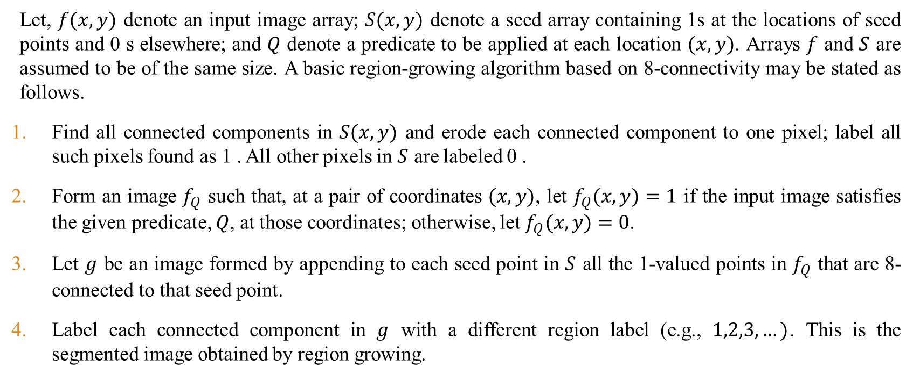
Region Growing Algorithm
Let, $f(x,y)$ denote an input image array; $S(x,y)$ denote a seed array containing 1s at the locations of seed points and 0 s elsewhere; and $Q$ denote a predicate to be applied at each location $(x,y)$. Arrays $f$ and $S$ are assumed to be of the same size. A basic region-growing algorithm based on 8-connectivity may be stated as follows.
Find all connected components in $S(x,y)$ and erode each connected component to one pixel; label all such pixels found as 1 . All other pixels in $S$ are labeled 0 .
Form an image $f_{Q}$ such that, at a pair of coordinates $(x,y)$, let $f_{Q}(x,y)=1$ if the input image satisfies the given predicate, $Q$, at those coordinates; otherwise, let $f_{Q}(x,y)=0$.
Let $g$ be an image formed by appending to each seed point in $S$ all the 1-valued points in $f_{Q}$ that are 8-connected to that seed point.
Label each connected component in $g$ with a different region label (e.g., $1,2,3,…)$. This is the segmented image obtained by region growing.

Slide 52
Region Growing
Advantages
Borders found are perfectly thin and connected.
Algorithm is stable with respect to noise.

Slide 53
Region Splitting and Merging
Top-down approach
Opposite of region growing
General Procedure
- First there is a large region (possibly the entire image)
- Then a predicate (measurement) is used to determine if the region is uniform
- If not, split the region into four regions
- Then each of these four regions is independently tested by the predicate (measurement)
- This procedure continues until all resulting regions are uniform

Slide 54
Thank You ☺

